Slide 1
SocksDirect: Datacenter Sockets can be Fast and Compatible
Bojie Li*^{1,2} Tianyi Cui*³ Zibo Wang^{1,2} Wei Bai¹ Lintao Zhang¹
¹Microsoft Research ²USTC ³University of Washington
* Co-first authors
Presenter: Bojie Li
Distributed and Parallel Software Lab, Central Software Institute, Huawei 2012 Labs

Slide 2
The Socket Communication Primitive
Server
Client
socket()
bind()
listen()
accept()
recv()
send()
close()
socket()
connect()
send()
recv()
close()
Notes:
As we all know, most applications use the socket primitive for inter-process communication, both within a same server and among different servers.

Slide 3
Socket: a Performance Bottleneck
Socket syscall time >> user application time
Socket latency >> hardware transport latency
Notes:
Traditionally, sockets are implemented in the OS kernel. We all know that kernel socket is very slow. To show this point, we profile several popular applications in data centers. We can see that 70% to 90% of CPU time is used in OS kernel, which means it is handling the socket system calls. If we could eliminate the overhead of OS kernel and all CPU time can be utilized by the user space application, the application throughput will improve by several times.
Next we look at the latency, and the problem is more severe than throughput. For communication between two directly connected servers, socket latency is 17x of RDMA. For intra-host communication, socket latency is 40x of shared memory queue. In this work, we try to answer one question: is this socket overhead an intrinsic property of the socket abstraction, or we can do something to eliminate the socket overhead?

Slide 4
Timeline of the SocksDirect Project
2017/04 | Start research on high-performance socket, IPC and container networking.
2017/07 | IPC-Direct: Fast and Compatible Container Networking won the most impactful award and global 1st place in Cloud & Enterprise category in Microsoft Hackathon 2017.
2017/08 | Submitted a poster to SOSP’17 Student Research Competition, admitted in final presentation rounds.
2018/04 | First submission to OSDI’18 but rejected in first-round review. Major reasons: difference from related work; presentation is not clear.
2018/09 | Second submission to NSDI’19 but rejected in first-round review. Major reasons: design is too complicated; evaluation not solid.
2019/01 | Third submission to SIGCOMM’19 and accepted. Improve discussion on related work; remove unnecessary goals and simplify design; make the prototype work on real applications.

Slide 5
High Performance Socket Systems
Kernel Optimization
User-space TCP/IP
Offload to RDMA NIC
User App
User App
User App
User App
User App
User App
Kernel VFS
User-space VFS
User-space VFS
User-space VFS
User-space VFS
Kernel TCP/IP
User-space TCP/IP
User-space TCP/IP
NIC RDMA API Hardware-based Transport
NIC packet API
NIC packet API
TCP/IP
Host 1
TCP/IP
Host 1
RDMA
Host 1
Host 2
Host 2
Host 2
NIC packet API
NIC packet API
NIC RDMA API
Kernel
User-space Stack
User-space VFS
User App
User App
User App
FastSocket, Megapipe, StackMap…
IX, Arrakis, SandStorm, mTCP, LibVMA, OpenOnload…
Rsocket, SDP, FreeFlow…
Notes:
There have been extensive research to improve the performance of socket systems.
The first category is to optimize the kernel. A socket stack basically divides into three layers. The first layer is the virtual file system, VFS, because each socket connection is regarded as a file in Linux, and a file descriptor is mapped for the socket. The second layer is the kernel TCP/IP stack that provides the transport function. The third layer is the hardware interface layer. Linux kernel uses a packet API.
The second category is to implement the VFS abstraction and TCP/IP transport in the user space. It not only move the kernel functions into user space, but also greatly simplify the functions, for example, use polling to avoid the interrupt and process scheduling overheads.
The third category is to offload the transport to the NIC. Here we recall some history of hardware-based transports. TCP offload is not a new thing. In 1990s, there has been Ethernet cards that

Slide 6
Takeaways: related work
OSDI’18 Review: On the inter-server socket side, there have already been several proposals in socket over RDMA, including SDP, libvma, rsocket, OpenUCX, and UNH EXS. Among these, SDP, UNH EXS, rsocket all support zero copy (in some of their modes). There are no performance comparison with these solutions or related work discussion of SocksDirect's difference. There are also a bunch of user-level TCP/IP implementation.
OSDI’18 Review: There has been a whole lot of work on high-performance stacks… The related work (and Table 3) would do better to contrast with these in terms of design rather than features… You mention highly similar systems like mTCP, but completely fail to make any characterization about what insights or lessons you've had that are different than theirs. SDP has highly similar goals to yours, and contrary to what you claim in the related work section was designed to be transparent to applications.
OSDI’18 Review: Zero copy or shared memory communication isn’t new. Note that even recent Linux TCP stacks support zero copy.
SIGCOMM’19 PC Meeting Summary: We also feel that you need to relate your work to LITE (Tsai and Zhang, SOSP'17). While LITE does not allow transparent substitution, it has similar goals and techniques to your work.

Slide 7
Takeaways: related work / motivation
NSDI’19 Review: Another doubt I have is about the need to transparently support socket functionality in this richer set of scenarios. The paper makes the point that previous approaches do not work across fork, or that they do not support intra-machine communication. … But a practical question here is whether this support for full semantics is actually needed. I didn't see the compelling applications that do not work on previous approaches because such support is lacking.
NSDI’19 Review: Similarly, I strongly suspect that another reason that previous work has not focused on intra-machine performance is that the application scenarios haven't demanded it. … can you start the introduction by listing important applications that cannot use previous high-performance networking stacks because they lack support for fork, intra-machine communication, etc.?

Slide 8
Takeaways: related work / motivation
OSDI’18 Review: I did not understand why we should use a TCP socket for intra-machine communication instead of a unix domain socket or a pipe. The latter performs much better on Linux, but evaluation seems to miss this point.
NSDI’19 Review: I did not find the corresponding motivation for accelerating intra-host communication in this paper. You might want to show that (1) the performance of intra-host communication is critical for many applications and (2) what performance problems that existing kernel stacks have. The paper does not even show and compare the performance of unix domain sockets or pipes, and simply jumps on improving TCP sockets for intra-host communication.
OSDI’18 Review: Why do you use TCP sockets for intra-machine connections? Why not use a unix domain socket or a pipe? The following page says that using unix domain sockets or pipe() brings 3x better latency and produces 7x better throughput than a TCP connection. …
OSDI’18 Review: Using shared memory for IPC is common. The authors use it for socket communication across processes/threads.

Slide 9
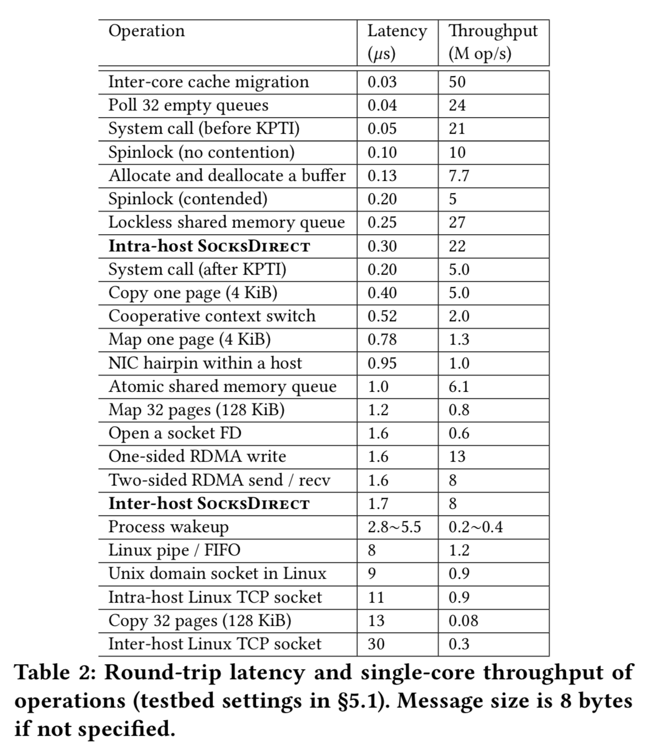
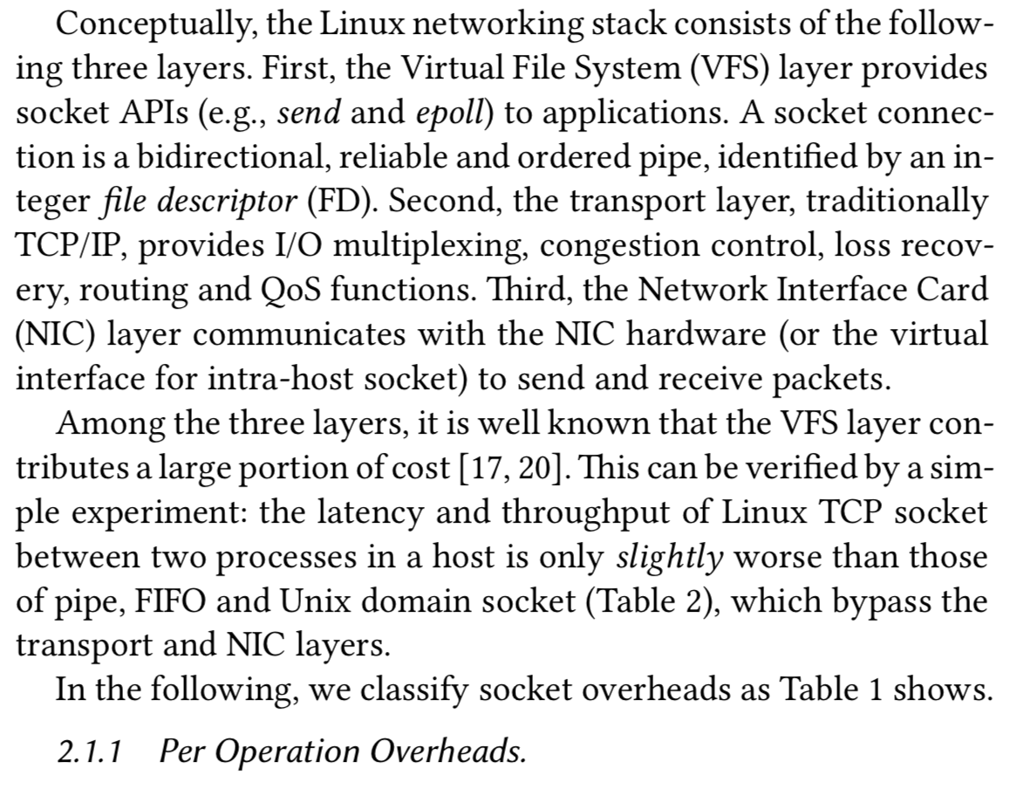

Slide 10
Linux Socket: from send() to recv()
Sender Host
Receiver Host
Application
Application
send() socket call
Wakeup process
recv() socket call
C library
C library
OS
OS
send() syscall
recv() syscall
Lock
Process Scheduling
Lock
VFS send
VFS recv
Copy data, allocate mem
Event Notification
Copy data, free mem
TCP send buffer
TCP recv buffer
TCP/IP
TCP/IP
Network packet
Network packet
Packet processing (netfilter, tc…)
Packet processing (netfilter, tc…)
Network packet
Network packet
NIC
NIC
Network packet

Slide 11
Round-Trip Time Breakdown
Type | Overhead (ns) | Linux |  | LibVMA |  | RSocket |  | SocksDirect
 |  | Inter-host | Intra-host | Inter-host | Intra-host | Inter-host | Intra-host | Inter-host | Intra-host
Per operation | Total | 413 |  | 177 |  | 209 |  | 53
 | C library shim | 12 |  | 10 |  | 10 |  | 15
 | Kernel crossing (syscall) | 205 |  | N/A |  | N/A |  | N/A
 | Socket FD locking | 160 |  | 121 |  | 138 |  | N/A
Per packet | Total | 15000 | 5800 | 2200 | 1300 | 1700 | 1000 | 850 | 150
 | Buffer management | 430 |  | 320 |  | 370 |  | 50
 | TCP/IP protocol | 360 |  | 260 |  | N/A |  | N/A
 | Packet processing | 500 | N/A | 130 |  | N/A |  | N/A
 | NIC doorbell and DMA | 2100 | N/A | 900 | 450 | 900 | 450 | 600 | N/A
 | NIC processing and wire | 200 | N/A | 200 | N/A | 200 | N/A | 200 | N/A
 | Handling NIC interrupt | 4000 | N/A | N/A |  | N/A |  | N/A
 | Process wakeup | 5000 |  | N/A |  | N/A |  | N/A
Per kbyte | Total | 365 | 160 | 540 | 381 | 239 | 212 | 173 | 13
 | Copy | 160 |  | 320 |  | 160 |  | 13
 | Wire transfer | 160 | N/A | 160 | N/A | 160 | N/A | 160 | N/A
Notes:
Categorize into per-operation, per-packet, per-kbyte overheads.
Linux: most overheads in NIC doorbell, DMA, handling NIC interrupt and process wakeup. Other overheads also contribute a large portion of overheads.
LibVMA:

Slide 12
Takeaways: performance breakdown
SIGCOMM’19 Review: I'd like to see experimental results that don't use the page-remapping technique, plus more details of how this can be managed securely.
SIGCOMM’19 Review: … it fails to highlight how the various pieces to the solution contribute to the performance gains. I would have liked to see the performance gains dissected in more details.
SIGCOMM’19 Review: I would expect that there are some performance vs. compatibility trade-offs here but the paper fails to highlight them and quantify where certain performance gaps existing.
SIGCOMM’19 PC Meeting Summary: There's a lot of engineering work in your solution, but the evaluation doesn't let us separate the relative costs and benefits of the individual choices.

Slide 13
SocksDirect Design Goals
Compatibility
Drop-in replacement, no application modification
Isolation
Security isolation among containers and applications
Enforce access control policies
High Performance
High throughput
Low latency
Scalable with number of CPU cores
Scalable with number of concurrent connections
Notes:
Why remove concurrent connections: When there is a connection,

Slide 14
Takeaways: remove unnecessary design goals which lead to a complicated design
NSDI’19 Review: Misleading claim. The intro says that the proposed system maintains good performance even with millions of concurrent connections, which sounds very nice. I later find out that this is for supporting millions of connections between TWO processes/threads as they multiplex a single queue for communication. But why is that important? What matters in practice is to support a large number of concurrent connections with millions of remote clients, where you can’t share a queue.
NSDI’19 Review: What is the usage scenario for supporting a million simultaneous connections between two processes over RDMA? The million connections scenario is a web server scenario, which is going to have a (relatively) small number of server processes and a huge number of external clients, and they will be using TCP since it's not internal to a data center.
The real problem in datacenter that SocksDirect did not solve: one storage/DB server with thousands of storage/DB clients, where the traffic is bursty.

Slide 15
SocksDirect: Fast and Compatible Socket in User Space
Monitor Process
ACL rules
Process 1
Process 2
Event queue
Event queue
Data
Data
Application
Shared Buffer
connect
send
recv
Application
accept
Request queue
Request queue
User Mode
Kernel Mode
Monitor: user-space daemon process to coordinate global resources and enforce ACL rules.
Processes as a shared-nothing distributed system: use message passing over shared-memory queues.

Slide 16
SocksDirect Supports Different Transports for Data
User App
User App
Mem Queue
Monitor
Mem Queue
libsd
libsd
Host 1
Mem Queue
TCP/IP
NIC RDMA API
NIC Packet API
RDMA
TCP/IP
NIC RDMA API
Host 2
libsd
Host 3
No SocksDirect
TCP/IP
User App
User App
Monitor

Slide 17
Remove the Overheads (1)
Type | Overhead | Linux RTT (ns) |  | SocksDirect RTT (ns)
 |  | Inter-host | Intra-host | Inter-host | Intra-host
Per operation | Total | 413 |  | 53
 | C library shim | 15 |  | 15
 | Kernel crossing (syscall) | 205 |  | N/A
 | Socket FD locking | 160 |  | N/A
Per packet | Total | 15000 | 5800 | 850 | 150
 | Buffer management | 430 |  | 50
 | TCP/IP protocol | 360 |  | N/A
 | Packet processing | 500 | N/A | N/A
 | NIC doorbell and DMA | 2100 | N/A | 600 | N/A
 | NIC processing and wire | 200 | N/A | 200 | N/A
 | Handling NIC interrupt | 4000 | N/A | N/A
 | Process wakeup | 5000 |  | N/A
Per kbyte | Total | 365 | 160 | 173 | 13
 | Copy | 160 |  | 13
 | Wire transfer | 160 | N/A | 160 | N/A

Slide 18
Remove the Overheads (2)
Type | Overhead | Linux RTT (ns) |  | SocksDirect RTT (ns)
 |  | Inter-host | Intra-host | Inter-host | Intra-host
Per operation | Total | 413 |  | 53
 | C library shim | 15 |  | 15
 | Kernel crossing (syscall) | 205 |  | N/A
 | Socket FD locking | 160 |  | N/A
Per packet | Total | 15000 | 5800 | 850 | 150
 | Buffer management | 430 |  | 50
 | TCP/IP protocol | 360 |  | N/A
 | Packet processing | 500 | N/A | N/A
 | NIC doorbell and DMA | 2100 | N/A | 600 | N/A
 | NIC processing and wire | 200 | N/A | 200 | N/A
 | Handling NIC interrupt | 4000 | N/A | N/A
 | Process wakeup | 5000 |  | N/A
Per kbyte | Total | 365 | 160 | 173 | 13
 | Copy | 160 |  | 13
 | Wire transfer | 160 | N/A | 160 | N/A

Slide 19
Takeaways: explain application scenario
Example: why need locking?
NSDI’19 Review: It is nice to handle sharing a socket with multiple senders or multiple receivers. However, while required for correct operation, such communication pattern is pretty unusual. Except for a popular scenario that shares a listening socket with multiple processes/threads, I think it would be rare for multiple senders to share a socket to send messages concurrently or the other way around (multiple receivers contend to receive messages simultaneously). If not, please explain which application does this.

Slide 20
Token-based Socket Sharing
Socket is shared among threads and forked processes.
Many to one
One to many
Optimize for common cases.
Be correct for all cases.
Many to one
One to many
Transfer ownership of tokens via monitor.
Lock
Sender 1
Sender 1
Queue
Receiver
Queue
Receiver
Sender 2
Sender 2
Send
token
Lock
Receiver 1
Receiver 1
Sender
Queue
Sender
Queue
Receiver 2
Receiver 2
Receive
token

Slide 21
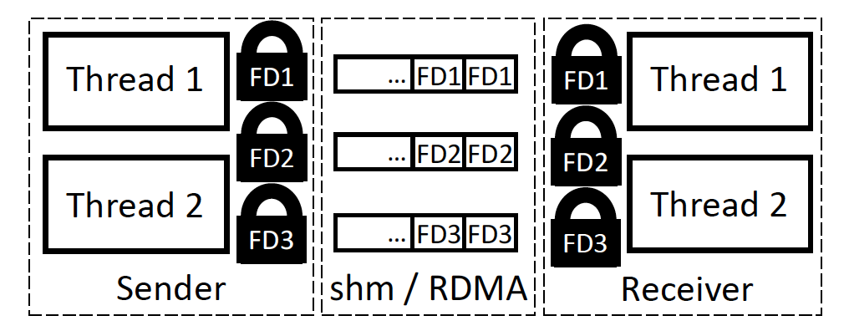
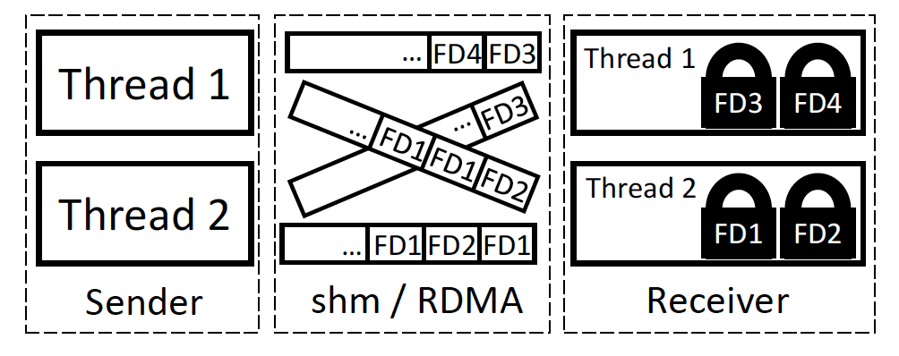
Takeaways: remove unnecessary design goals which lead to a complicated design
Traditional queue
1 FD = 1 queue
All threads share a queue
Multiplexed queue in previous submissions
N FDs share 1 queue
1 queue per send/recv thread pair
OSDI’18 Review: Not sure what’s the benefit of a single queue for all connections of two communicating machines? I think such a design choice makes the implementation unnecessarily complex (e.g., picking from middle of queue). You might want to compare the performance of a single aggregate queue vs. a per-connection queue.

Slide 22
Handling Fork
Linux semantics requirement:
File descriptors need to be sequential (1,2,3,4,5…).
Sockets are shared for parent and child processes.
Transport limitations:
RDMA QP cannot be shared among processes.
Parent process
RDMA QP
3
5
RDMA QP
3
FD Table
5 (COW)
SHM (shared)
Shared pages
Socket Data
3
4
5
Socket Data
3
4
SHM (shared)
FD Table
3
4
SHM Queue
4
Child process
SHM (private)
RDMA QP
3 (on demand)
5
FD Table
5 (COW)
Socket Data
5

Slide 23
Takeaways: make trade-offs
OSDI’18 Review: The Linux socket semantics is that "The file descriptor returned by a successful call will be the lowest-numbered file descriptor not currently open for the process." (http://man7.org/linux/man-pages/man2/socket.2.html), which would no longer be true. This change would break (potentially buggy) applications that rely on low-numbered socket descriptors as an index to an array.
In NSDI’19 submission, we found that Redis and Memcached rely on the lowest FD behavior.
NSDI’19 Review: In section 3.2, your system maintains an FD translation table to be compatible with the POSIX standard that returns the lowest unused FD for a new FD. While this maintains the compatibility with existing applications, it incurs a high overhead on a busy server in practice. … Note that other high-performance TCP/IP stacks like MegaPipe and mTCP intentionally avoid this overhead by not conforming to the requirement.
In SIGCOMM’19 submission, we no longer claim socket establishment throughput because it is not important at all in datacenters! (Remove unnecessary design goals)

Slide 24
Remove the Overheads (3)
Type | Overhead | Linux RTT (ns) |  | SocksDirect RTT (ns)
 |  | Inter-host | Intra-host | Inter-host | Intra-host
Per operation | Total | 413 |  | 53
 | C library shim | 15 |  | 15
 | Kernel crossing (syscall) | 205 |  | N/A
 | Socket FD locking | 160 |  | N/A
Per packet | Total | 15000 | 5800 | 850 | 150
 | Buffer management | 430 |  | 50
 | TCP/IP protocol | 360 |  | N/A
 | Packet processing | 500 | N/A | N/A
 | NIC doorbell and DMA | 2100 | N/A | 600 | N/A
 | NIC processing and wire | 200 | N/A | 200 | N/A
 | Handling NIC interrupt | 4000 | N/A | N/A
 | Process wakeup | 5000 |  | N/A
Per kbyte | Total | 365 | 160 | 173 | 13
 | Copy | 160 |  | 13
 | Wire transfer | 160 | N/A | 160 | N/A

Slide 25
Per-socket Ring Buffer
head
head
tail
tail
Traditional ring buffer
SocksDirect per-socket ring buffer
Many sockets share a ring buffer
Receiver segregates packets from the NIC
Buffer allocation overhead
Internal fragmentation
One ring buffer per socket
Sender segregates packets via RDMA or SHM address
Back-to-back packet placement
Minimize buffer mgmt. overhead

Slide 26
Per-socket Ring Buffer
send_next
RDMA write data
head
tail
Sender side
Receiver side
RDMA write credits (batched)
Two copies of ring buffers on both sender and receiver.
Use one-sided RDMA write to synchronize data from sender to receiver, and return credits (i.e. free buffer size) in batches.
Use RDMA write with immediate verb to ensure ordering and use a shared completion queue to amortize polling overhead.

Slide 27
Takeaways: refine design according to reviews
NSDI’19 Review: How does SocksDirect recover when the other endpoint fails?
Our approach: two copies of ring buffers on both sender and receiver. (It also enables batching.)

Slide 28
Remove the Overheads (4)
Type | Overhead | Linux RTT (ns) |  | SocksDirect RTT (ns)
 |  | Inter-host | Intra-host | Inter-host | Intra-host
Per operation | Total | 413 |  | 53
 | C library shim | 15 |  | 15
 | Kernel crossing (syscall) | 205 |  | N/A
 | Socket FD locking | 160 |  | N/A
Per packet | Total | 15000 | 5800 | 850 | 150
 | Buffer management | 430 |  | 50
 | TCP/IP protocol | 360 |  | N/A
 | Packet processing | 500 | N/A | N/A
 | NIC doorbell and DMA | 2100 | N/A | 600 | N/A
 | NIC processing and wire | 200 | N/A | 200 | N/A
 | Handling NIC interrupt | 4000 | N/A | N/A
 | Process wakeup | 5000 |  | N/A
Per kbyte | Total | 365 | 160 | 173 | 13
 | Copy | 160 |  | 13
 | Wire transfer | 160 | N/A | 160 | N/A

Slide 29
Zero Copy via Page Remapping
Send physical page
Sender
Receiver
Virtual addr
Virtual addr
New page
Data page
Old page
Problem: page remapping needs syscalls!
Map 1 page: 0.78 us
Copy 1 page: 0.40 us
Solution: batch page remapping for large messages
Map 32 pages: 1.2 us
Copy 32 pages: 13.0 us

Slide 30
Summary: Overheads & Techniques
Kernel crossing (syscall) Monitor and library in user space. Shared-nothing, use message passing for communication.
TCP/IP protocol Use hardware-based transports: RDMA / SHM.
Locking of socket FDs Token-based socket sharing. Optimize common cases, prepare for all cases.
Buffer management Per-socket ring buffer.
Payload copy Batch page remapping.
Process wakeup Cooperative context switch.

Slide 31
Evaluation Setting
User App
User App
Mem Queue
Monitor
Mem Queue
libsd
libsd
Host 1
Mem Queue
NIC RDMA API
RDMA
NIC RDMA API
Host 2
libsd
User App
Monitor
Notes:
Use LD_PRELOAD to load libsd library.
Intra-host
Inter-host

Slide 32
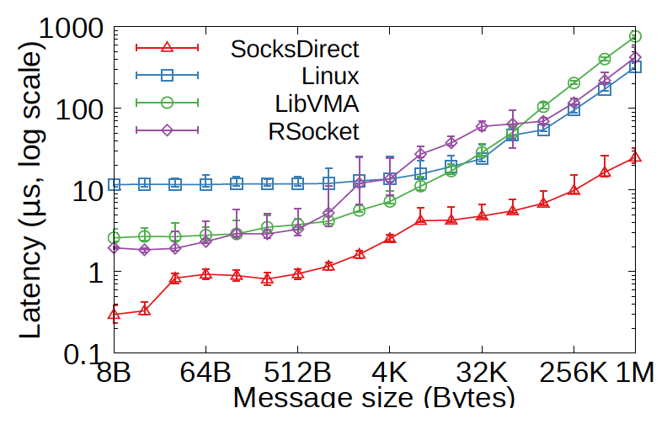
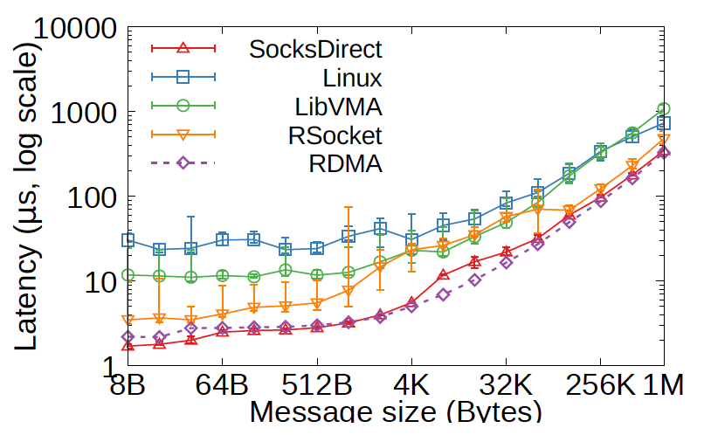
Latency
Intra-host
Inter-host
Notes:
Intra-host: 8B latency close to shared memory queue, 4x lower than Rsocket and LibVMA because they use NIC to forward intra-host packets. 35x lower than Linux.
Inter-host: 8B latency even lower than two-sided RDMA send and receive, because we use one-sided RDMA write. Half of Rsocket, performance gain due to buffer management. 7x lower than LibVMA because it needs batching. Latency 17x lower than Linux.

Slide 33
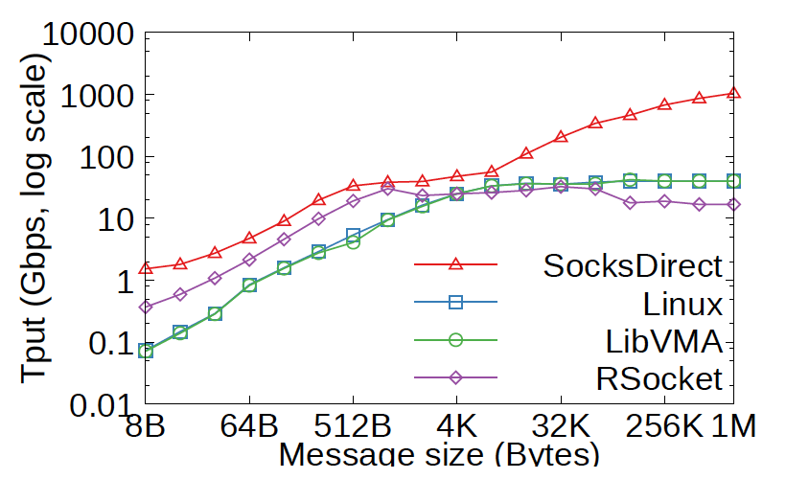
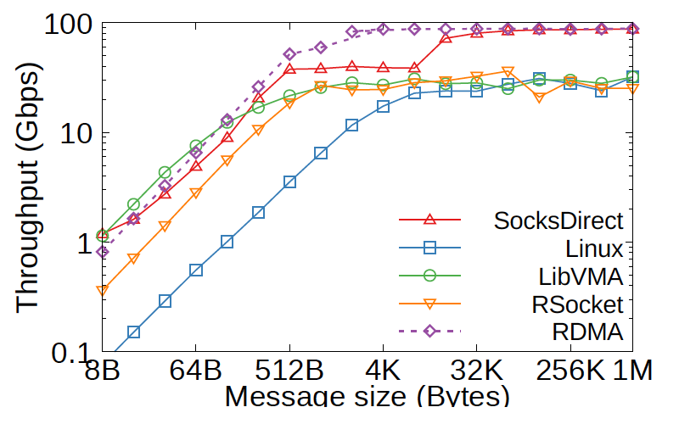
Throughput
Intra-host
Inter-host
Notes:
Intra-host: 8B message throughput 20x of Linux. At 8K it is closest to other systems because we need batching for zero copy, and it is only activated for >=16KB messages. Large messages 13x of Linux.
Inter-host: 8B message throughput 15x of Linux. One socket connection can saturate the 100Gbps link.

Slide 34
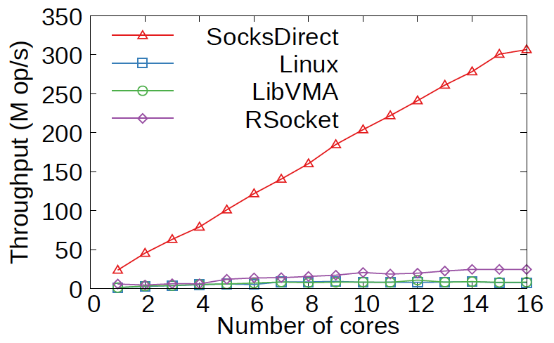
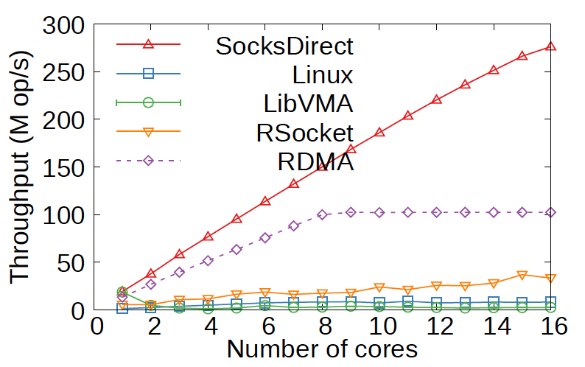
Multi-core Scalability
Intra-host
Inter-host
Notes:
Multi-core scalability: SocksDirect almost linearly scalable. Other systems not linearly scalable due to file descriptor locking and packet queue contention. With higher number of cores, the throughput is even worse.
For inter-host, SocksDirect has even higher throughput than bare metal RDMA, because we have batching.

Slide 35
Takeaways: evaluate not only the best cases
SIGCOMM’19 Review: It also does not help that the evaluation presents results that appear to have been cherry-picked to put SocksDirect in the best scenario.
SIGCOMM’19 Review: I would have liked to see a more thorough evaluation and I would have expected that the paper highlights where SocksDirect is not ideal. Currently my feeling is that these results were chosen as they show the best scenarios.
OSDI’18 Review: Really importantly, what are the edges of your system that don't perform well, or are hard to deploy and maintain? What are the important tradeoffs?

Slide 36
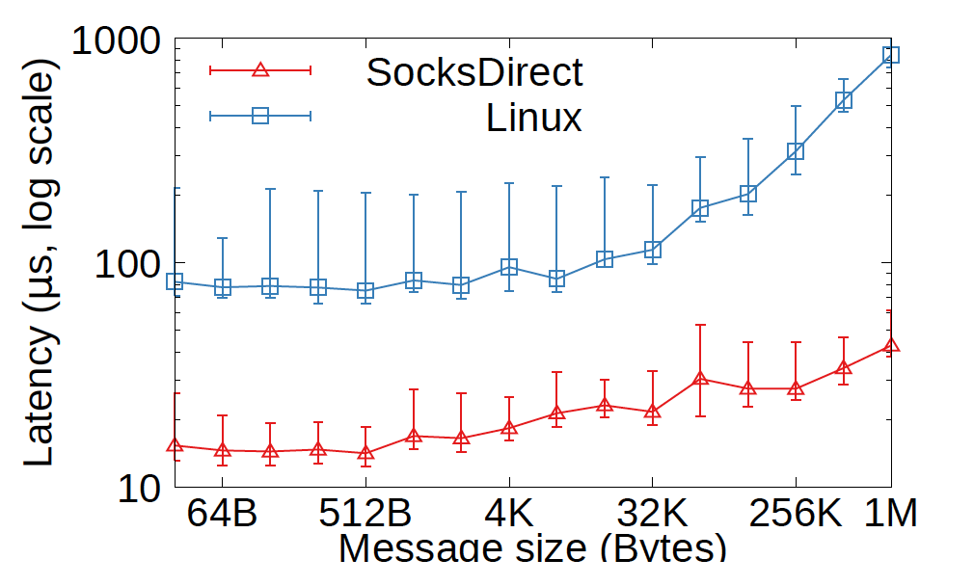
Application Performance
Nginx HTTP server request latency
Notes:
Nginx HTTP server between two hosts: small HTTP messages, 5x lower than Linux. For large message, 13x lower than Linux due to zero copy.

Slide 37
Takeaways: evaluate with practical applications
NSDI’19 Review: Evaluation setup (in Section 6) is weird. Running a load balancer, web service, and key-value store on the same machine is pretty unconvincing. This seems to emphasize the performance of your intra-host communication, but I don’t think people would provision the services on a single machine.
OSDI’18 Review: What is the experimental setup for the applications in 6.2? What are the load balancer, the web service, and the KV store? Are they located on the same or different machines? If they are on different machines are they communicating using TCP or RDMA?

Slide 38
Conclusion
Contributions of this work:
An analysis of performance overheads in Linux socket.
Design and implementation of SocksDirect, a high performance user space socket system that is compatible with Linux and preserves isolation among applications.
Techniques to support fork, token-based connection sharing, allocation-free ring buffer and zero copy that may be useful in many scenarios other than sockets.
Evaluations show that SocksDirect can achieve performance that is comparable with RDMA and SHM queue, and significantly speedup existing applications.

Slide 39
Closing Thoughts
Rejections are common.
Rejections are constructive.
Published papers are not perfect.
Talk with experts both inside and outside your institution.
There is no new thing under the sun. The solution to your (sub-)problem may be already in a paper twenty years ago, or in a paper of another field.
Think why many old, failed techniques are reinvented 30 years later and become successful.

Slide 40
Thank you! Wish your papers get accepted by the next major conference. Ad: Welcome to Parallel and Distributed Software Lab, Central Software Institute, Huawei 2012 Labs.
Notes:
Thank you for listening!

